Slide 1
U4611A Calibration setting study1 for output optimization
Agilent technologies
Application Engineer
Atsuki Okazaki

Slide 2
Agenda
For output optimization
  For Near End
  For 1m cable + no channel
  For 3m cable + no channel
  For 3m cable + Device channel (5inch)
  For 3m cable + Host channel (11inch)
  For 3m cable + Device channel + CLTE On
  For 3m cable + Host channel + CLTE On
  Reference Tx compliance result

Slide 3
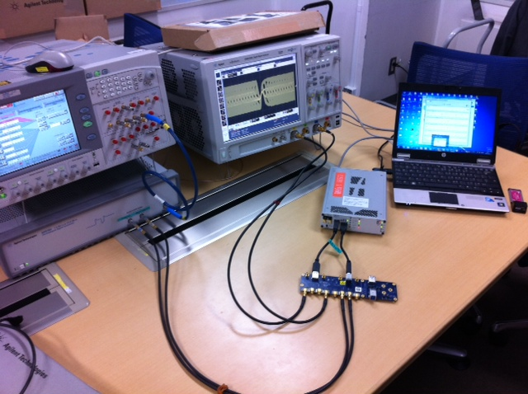
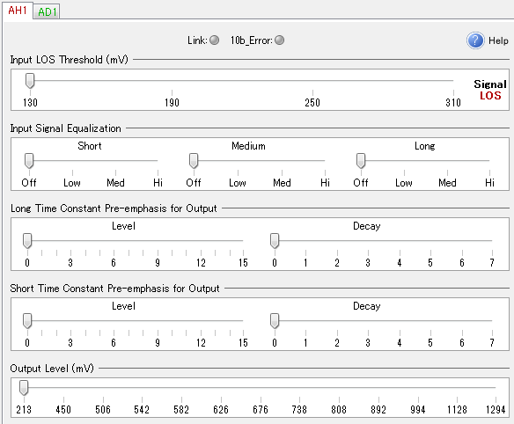
For output optimization basic test setup
Test Setup
BERT
Scope
U4611A
into
Std A port
From
Std B port
BERT sends out CP0 pattern (no jitter, SSC on)
CP0 goes into U4611A’s std A port
U4611A repeats CP0 from Std B port
Repeated CP0 goes into scope
Capture the waveform and draw Eye diagram
Tune the output cal setting and seek for best setting

Slide 4
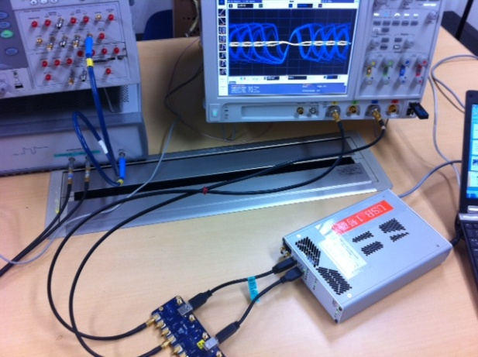
For Near End optimization
800mVp-p
Without De-emphasis
CP0
SSC on (-5000ppm)
No Jitter
Ch1 – Ch3
Second order PLL 4.9MHz
500k point
Eye height and width
BERT
U7242A
+
Short cable
U4611A
Scope
into
Std A port
From
Std B port

Slide 5
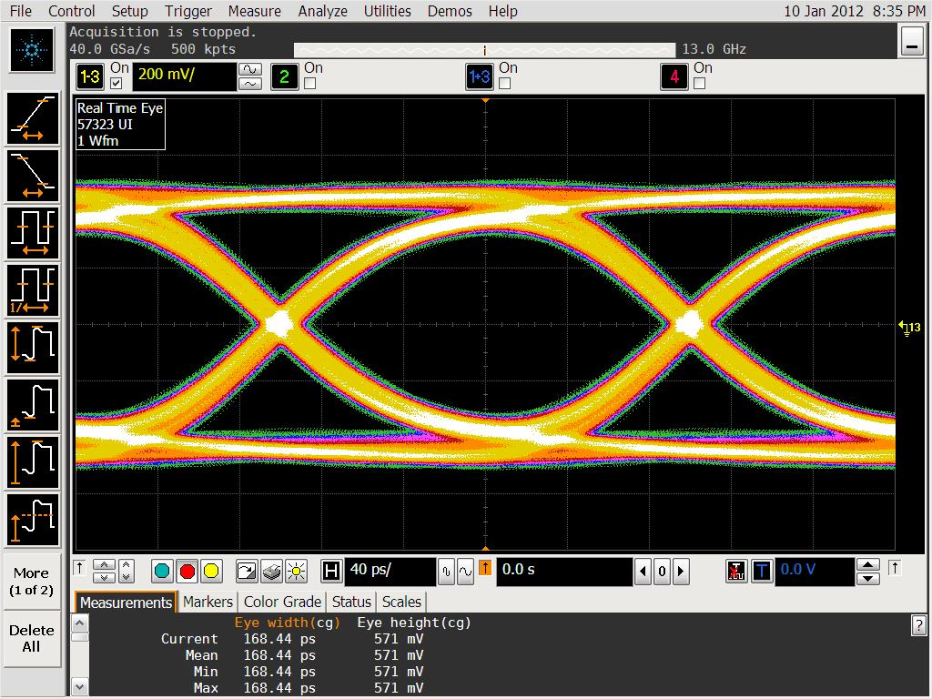
For Near End optimization
Best setting
  Long time Constant Pre-emphasis
    Level 3 / Decay 0
  Short time Constant Pre-emphasis
    Level 0 / Decay 0
  Output level
    994mV

Slide 6
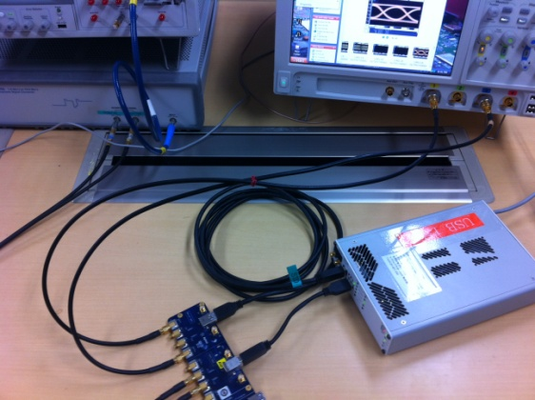
For 3m cable + no channel optimization
800mVp-p
Without De-emphasis
CP0
SSC on (-5000ppm)
No Jitter
Ch1 – Ch3
Second order PLL 4.9MHz
500k point
Eye height and width
BERT
U7242A
+
3m cable
U4611A
Scope
into
Std A port
From
Std B port

Slide 7
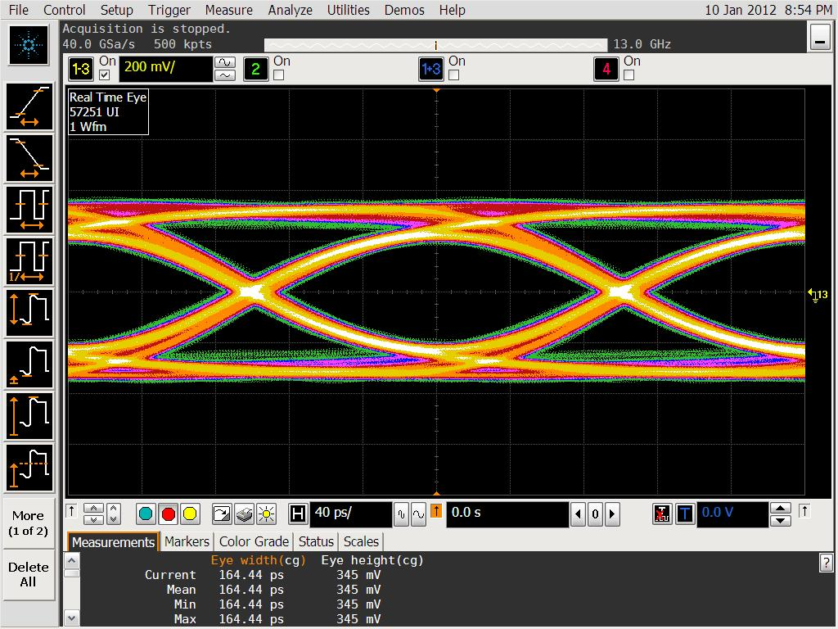
For 3m cable + no channel optimization
Best setting
  Long time Constant Pre-emphasis
    Level 11 / Decay 1
  Short time Constant Pre-emphasis
    Level 0 / Decay 0
  Output level
    582mV

Slide 8
For 3m cable + Device channel (5inch)
800mVp-p
Without De-emphasis
CP0
SSC on (-5000ppm)
No Jitter
Ch1 – Ch3
Second order PLL 4.9MHz
500k point
Eye height and width
BERT
U7242A
+
short cable
Infiniisim
S-para
simulation
U4611A
Scope
into
Std A port
De-embed “U7242+short cable”
& Embed “3m+device channel”

Slide 9
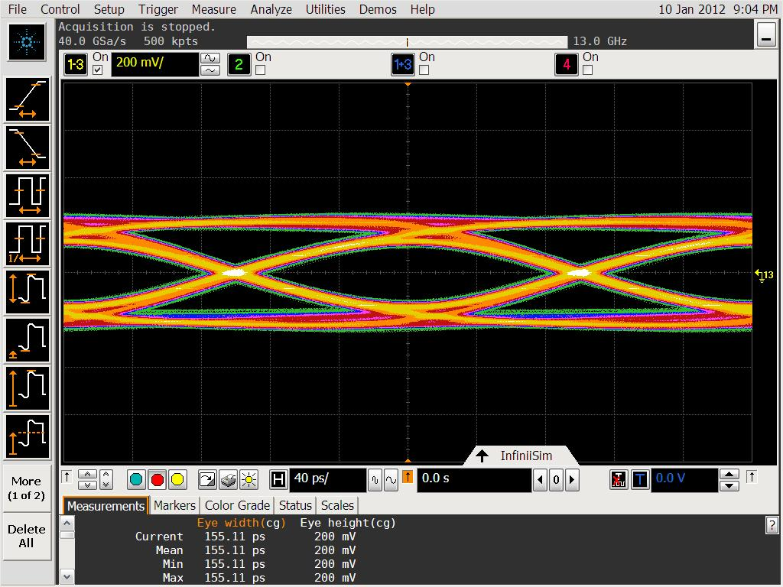
For 3m cable + device channel optimization
Best setting
  Long time Constant Pre-emphasis
    Level 0 / Decay 0
  Short time Constant Pre-emphasis
    Level 14 / Decay 6
  Output level
    216mV

Slide 10
For 3m cable + Host channel (11inch)
800mVp-p
Without De-emphasis
CP0
SSC on (-5000ppm)
No Jitter
Ch1 – Ch3
Second order PLL 4.9MHz
500k point
Eye height and width
BERT
U7242A
+
short cable
Infiniisim
S-para
simulation
U4611A
Scope
into
Std A port
De-embed “U7242+short cable”
& Embed “3m+Host channel”

Slide 11
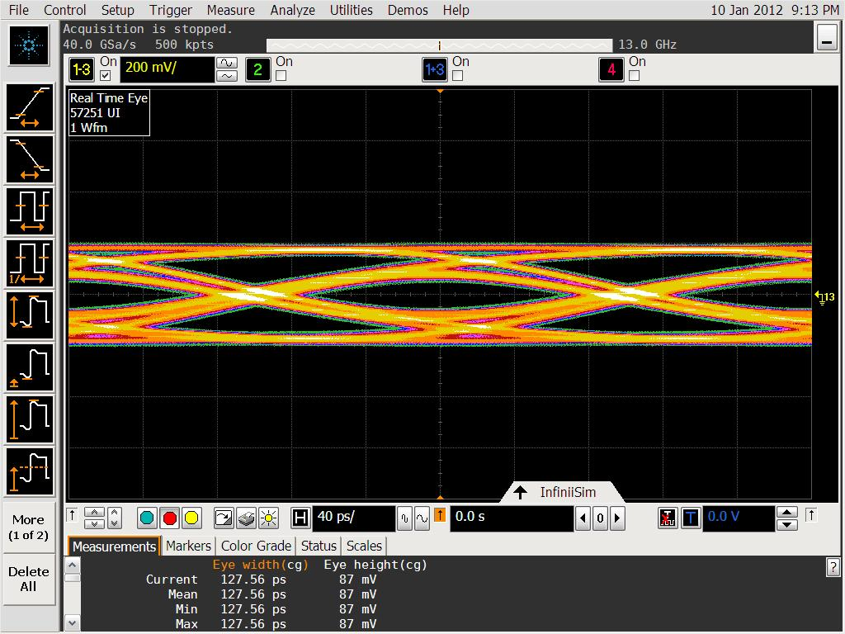
For 3m cable + host channel optimization
Best setting
  Long time Constant Pre-emphasis
    Level 0 / Decay 0
  Short time Constant Pre-emphasis
    Level 14 / Decay 6
  Output level
    216mV

Slide 12
For 3m cable + Device channel + CLTE
800mVp-p
Without De-emphasis
CP0
SSC on (-5000ppm)
No Jitter
Ch1 – Ch3
Second order PLL 4.9MHz
500k point
Eye height and width
BERT
U7242A
+
short cable
Infiniisim
S-para
simulation
CTLE
SIM
Scope
U4611A
into
Std A port
De-embed “U7242+short cable”
& Embed “3m+device channel”

Slide 13
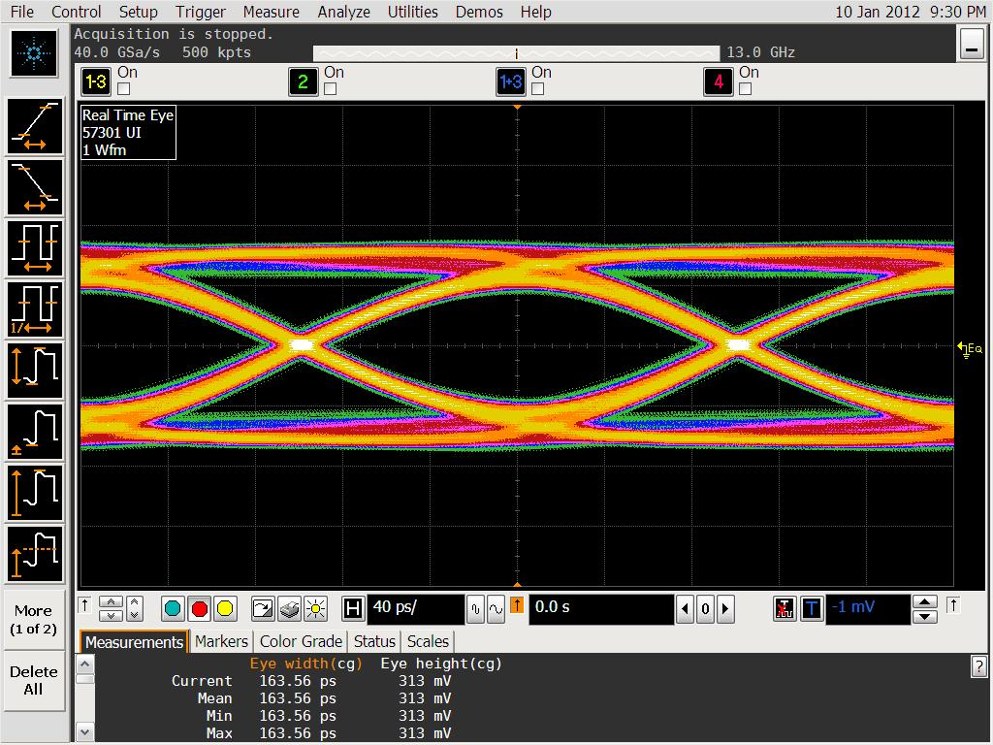
For 3m cable + device channel + CLTE optimization
Best setting
  Long time Constant Pre-emphasis
    Level 3 / Decay 2
  Short time Constant Pre-emphasis
    Level 0 / Decay 0
  Output level
    994mV

Slide 14
For 3m cable + Host channel + CLTE
800mVp-p
Without De-emphasis
CP0
SSC on (-5000ppm)
No Jitter
Ch1 – Ch3
Second order PLL 4.9MHz
500k point
Eye height and width
BERT
U7242A
+
short cable
Infiniisim
S-para
simulation
CTLE
SIM
Scope
U4611A
into
Std A port
De-embed “U7242+short cable”
& Embed “3m+host channel”

Slide 15
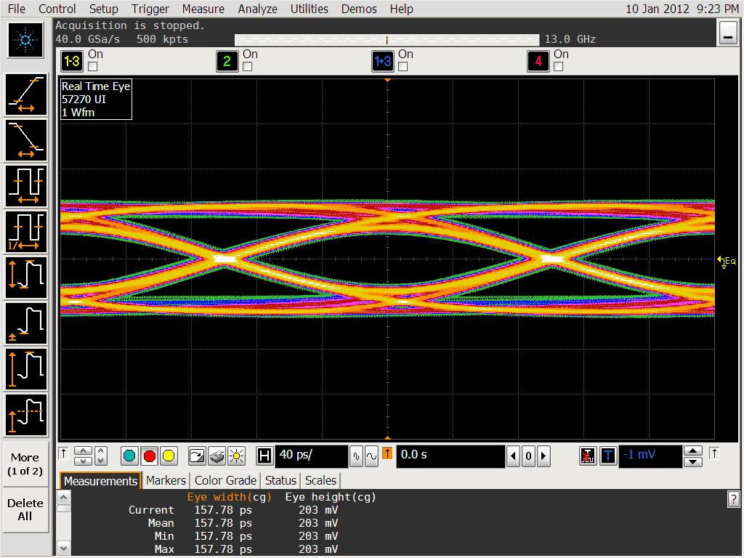
For 3m cable + host channel + CLTE optimization
Best setting
  Long time Constant Pre-emphasis
    Level 6 / Decay 0
  Short time Constant Pre-emphasis
    Level 0 / Decay 0
  Output level
    808mV

Slide 16
Result
 | Long Level | Long Decay | Short Level | Short Decay | Output Level
Near End | 3 | 0 | 0 | 0 | 994
3m cable | 11 | 1 | 0 | 0 | 582
3m + Device | 0 | 0 | 14 | 6 | 216
3m + host | 0 | 0 | 14 | 6 | 216
3m + Device + CLTE | 3 | 2 | 0 | 0 | 994
3m + Host + CLTE | 6 | 0 | 0 | 0 | 892

Slide 17
TX Compliance
 | Long Level | Long Decay | Short Level | Short Decay | Output Level
3m + Device + CLTE | 3 | 2 | 0 | 0 | 994
All Pass

